Slide 1
Hedging Strategy with Black-Scholes Equation’s Greeks
김수환
201821536
이준형
201821537
최노선
201821525

Slide 2
C
O N
T
E
N
T
S
1. Purpose & Methods
2. Greeks
3. Taylor Approximation
4. How to Hedge
5. Data & Code
6. Conclusion
Notes:
그릭스
테일러 근사
헤지 방법
데이터+코드
결과 비교
결론

Slide 3
Purpose & Methods
“ How does Maintain option premium
with the degree of Greeks hedge? ”
1. Decide the Call option to sell and its quantity
2. Find Greeks of Call option with BSM
3. Hedge using Greeks and find pay-off

Slide 4
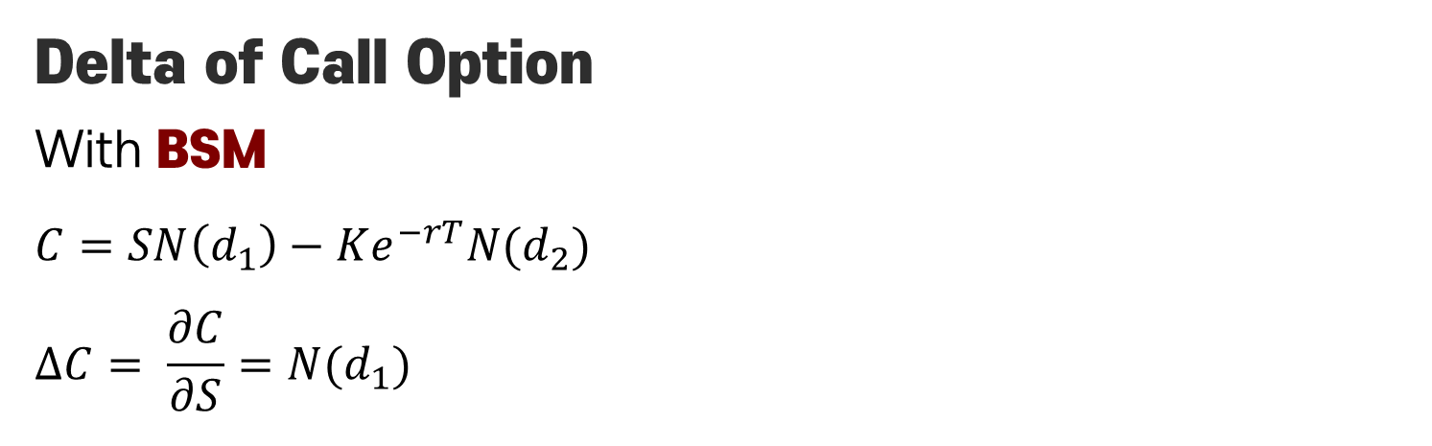
Greeks
Delta(Δ)
The rate of change of the option value concerning
changes in the underlying asset’s price
Delta of Call Option
With BSM
$$C=SN\left(d_{1}\right)−Ke^{−rT}N(d_{2})$$
$$∆C= \frac{∂C}{∂S}=N(d_{1})$$

Slide 5
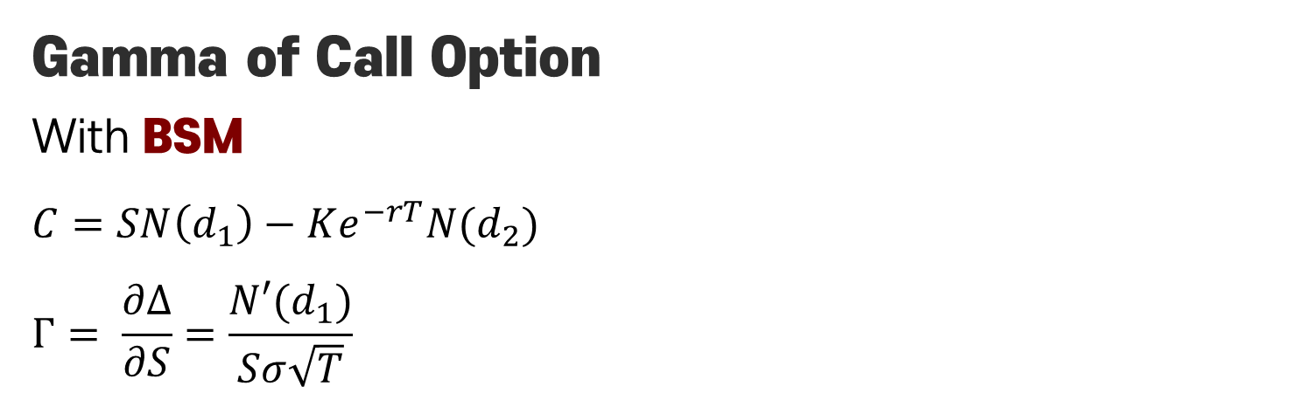
Greeks
Gamma(Γ)
The rate of change in the delta concerning
changes in the underlying asset’s price
Gamma of Call Option
With BSM
$$C=SN\left(d_{1}\right)−Ke^{−rT}N(d_{2})$$
$$Γ= \frac{∂Δ}{∂S}=\frac{N′(d_{1})}{Sσ\sqrt{T}}$$

Slide 6

Greeks
Vega(ν)
Change of the option value with respect to
the volatility of the underlying asset
Delta of Call Option
With BSM
$$C=SN\left(d_{1}\right)−Ke^{−rT}N(d_{2})$$
$$ν= \frac{∂C}{∂σ}=\frac{∂P}{∂σ}=S\sqrt{T}N′(d_{1})$$

Slide 7
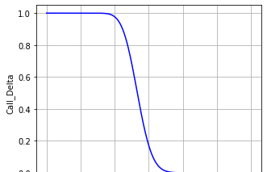
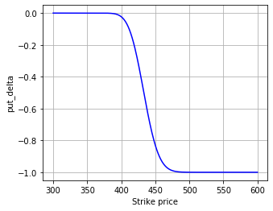
Greeks
+1
Δ-Call
Δ-Call and Δ-Put
are always different in
sign
0
Δ-Put
-1

Slide 8
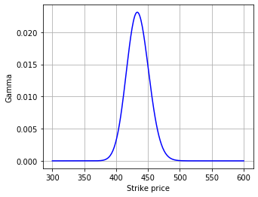
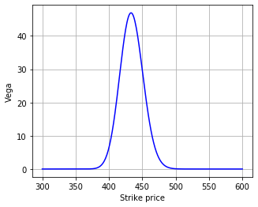
Greeks
Γ-Call = Γ-Put
ν-Call = ν-Put
But they have same Γ & ν
Therefore, it is appropriate to hedge Call option with Call option

Slide 9
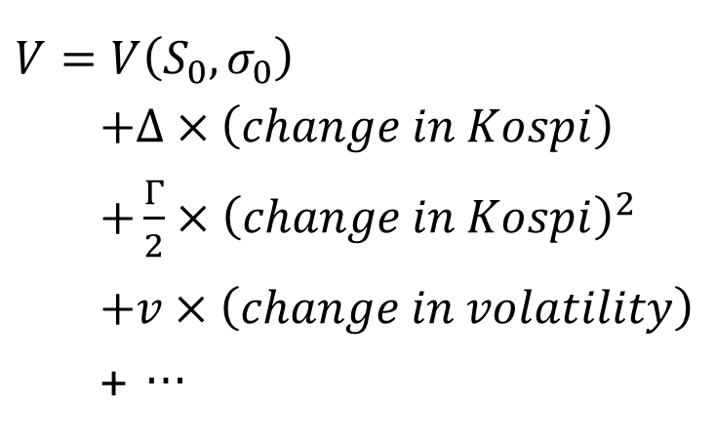
Taylor Approximation
The Value of Call option can be expressed
by Taylor Approximation
$$V=V\left(S_{0},σ_{0}\right)$$
$+Δ×\left(change in Kospi\right)$
$+\frac{Γ}{2}×{\left(change in Kospi\right)}^{2}$
$+v×\left(change in volatility\right)$
+ …
By removing each term,
Can Delta(Δ) Hedge
Can Gamma(Γ) Hedge
Can Vega(ν) Hedge

Slide 10
How to Hedge
How to remove each term,
to Delta(Δ) Hedge?
With Underlying Asset
to Gamma(Γ) & Vega(ν) Hedge?
With two other Options
By solving Simultaneous Equation of Gamma & Vega

Slide 11
How to Hedge
Option to be Hedged
We chose the ‘Kospi200 Call 202105 435.0’,
which has the closest Strike price to the Kospi200 price on April 15.
April 15 is four weeks before the Option Expiration Date, May 13.
Option to Hedge Gamma & Vega
‘Kospi200 Call 202105 440.0’
‘Kospi200 Call 202105 445.0’

Slide 12
Data & Code
Call Option & Kospi200 price
Using 한국증권거래소(KRX) data service
- Kospi200 C 202105 435.0
- Kospi200 C 202105 440.0
Kospi200 C 202105 445.0
Kospi200
2021.04.15~2021.05.13 price data
*2021.05.13 – Option Expiration Date

Slide 13
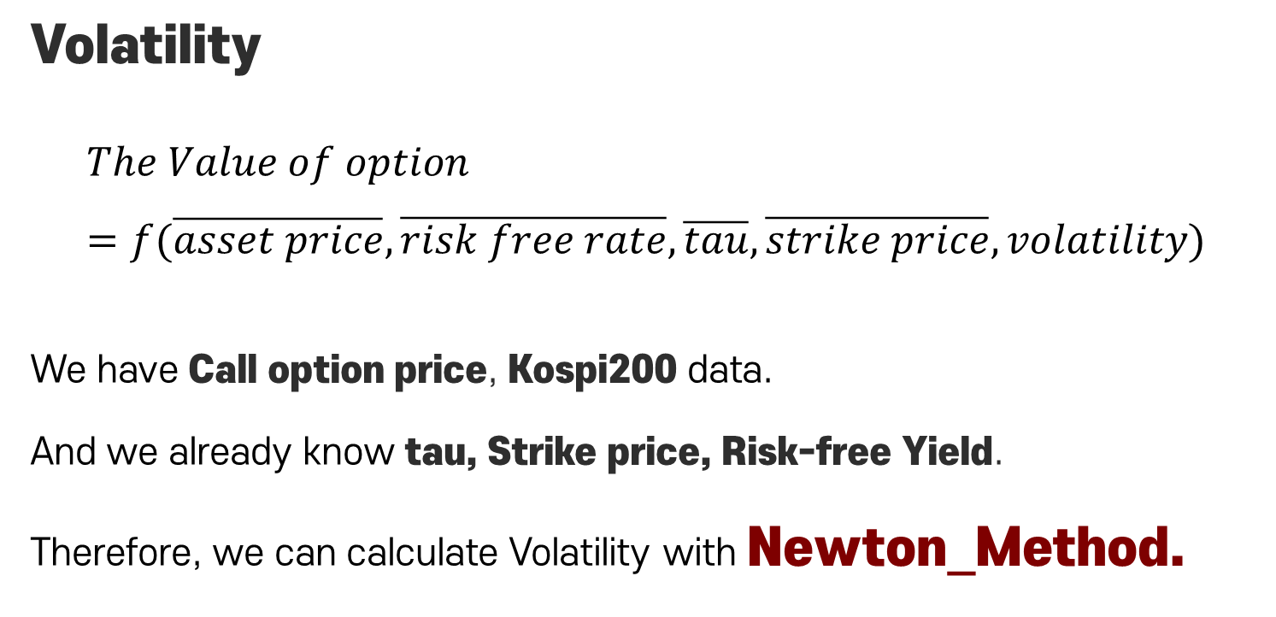
Data & Code
Volatility
$$The Value of option=f(\overline{asset price}, \overline{risk free rate}, \overline{tau}, \overline{strike price}, volatility)$$
We have Call option price, Kospi200 data.
And we already know tau, Strike price, Risk-free Yield.
Therefore, we can calculate Volatility with Newton_Method.

Slide 14
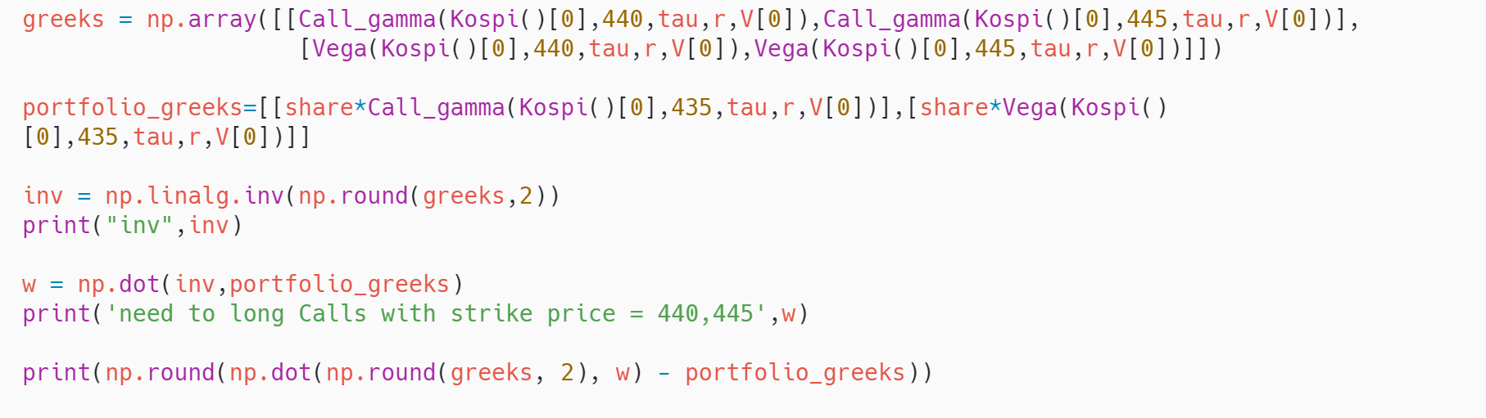
Data & Code
Hedging Code (Gamma Γ, Vega ν)
This code is same as solving this equation
$$\left[\begin{matrix}w_{1} \\ w_{2}\end{matrix}\right]={\left[\begin{matrix}Gamma of 440 & Gamma of 445 \\ Vega of 440 & Vega of 445\end{matrix}\right]}^{−1}\left[\begin{matrix}−Gamma of 435 \\ −Vega of 435\end{matrix}\right]$$

Slide 15
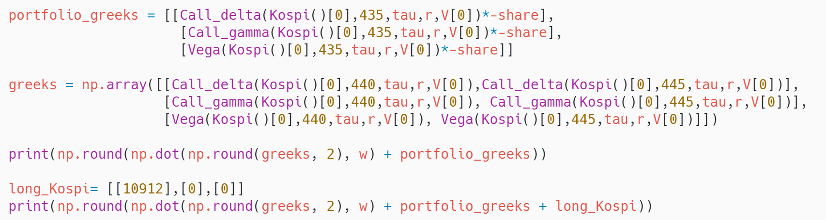
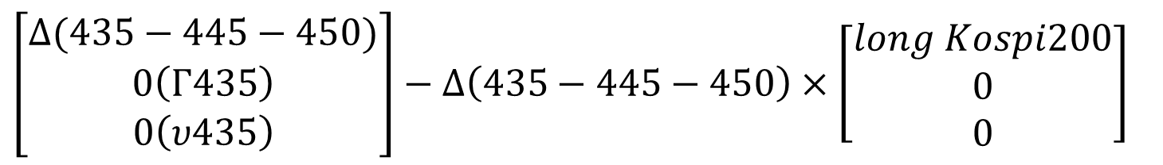
Data & Code
Hedging Code (Delta Δ)
This code is same as this calculation
$\left[\begin{matrix}Δ(435−445−450) \\ 0\left(Γ435\right) \\ 0\left(υ435\right)\end{matrix}\right]−Δ\left(435−445−450\right)×\left[\begin{matrix}long Kospi200 \\ 0 \\ 0\end{matrix}\right]$

Slide 16

Conclusion
Process
We sold 100,000 ‘Kospi200 Call 202105 435.0’
So, we made a pay-off of +5.87$×$100,000 on April 15
We’ve thought of 5 Scenarios to use this money
Use for Delta(Δ) hedge
Use for Delta(Δ) and Gamma(Γ) hedge
Use for Delta(Δ), Gamma(Γ) and Vega(ν) hedge
Deposit in Bank
Invest in Stocks

Slide 17
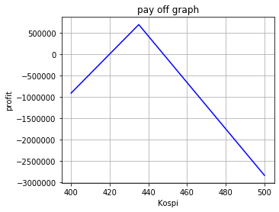
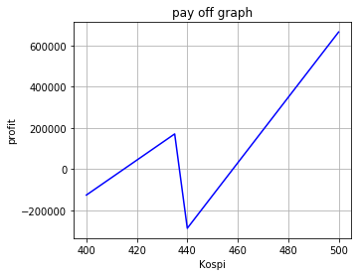
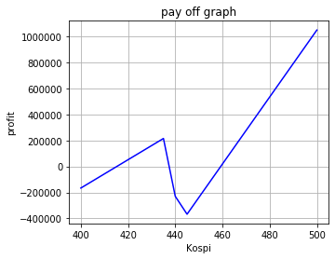
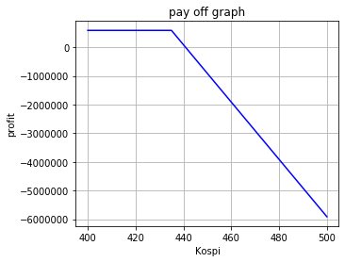

Pay-off Graph
Δ Hedge
Δ, Γ Hedge
Δ, Γ, ν Hedge
Bank
Stock

Slide 18
Pay-off Graph
Profit Results from Kospi200 Price on May 13
Δ Hedge
Δ, Γ Hedge
Δ, Γ, ν Hedge
-165,399
+10,212
+8,964
* Kospi200 price on May 13 = 416.07
Delta(Δ) hedge could not defend the option premium above a certain level
The Volatility in the data we have was not significant,
so we did not know how valid Vega(ν) hedge was.

Slide 19
Conclusion & Improvement
We can conclude following
“ Delta(Δ), Gamma(Γ) and
or more appropriate Greeks hedging
is helpful for maintain option premium.”
The effect of Vega hedging could have been greater
if we used data for 2020, which had high volatility.
If Revalancing had been considered,
It could have been more precise data.

Slide 20
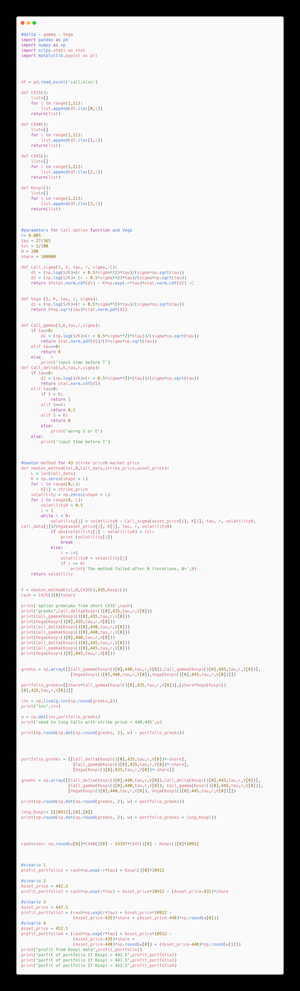
#Full Code

Slide 21
#Full Code

Slide 22
#Full Code

Slide 23
#Full Code

Slide 24
References
KOSPI200 지수 옵션을 합성한 변동성 매수 전략의
Greek’s Dynamic Decomposition 효과 연구
(A study on Greek’s dynamic decompositions effect of volatility long strategy with synthesized KOSPI200 index options)
-아주대학교 대학원 금융공학협동과정 김경한

